Slide 1
BALLOON SHOOTING…
Presenting By:
Mir arif hasan [16.02.04.077]
Mallik galib sHahriar [16.02.04.079]
Mir hasibul hasan rahat [16.02.04.081]

Slide 2
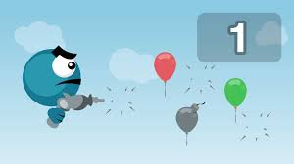
Gun Man

Slide 3
GAME INTRO
A gun man and different colors of balloons
Each color contain different points .
A dead balloon.
3 Levels .
Goal: Need 600 points to win.

Slide 4
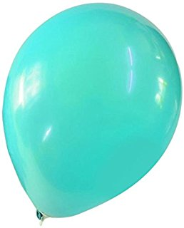
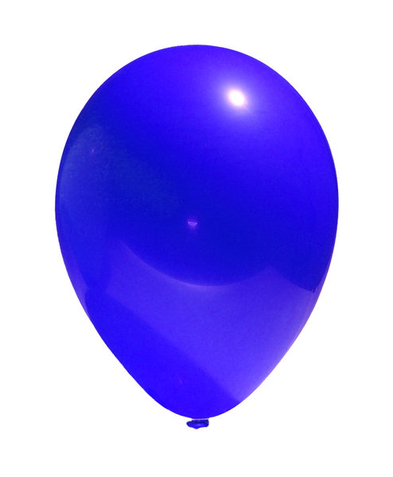
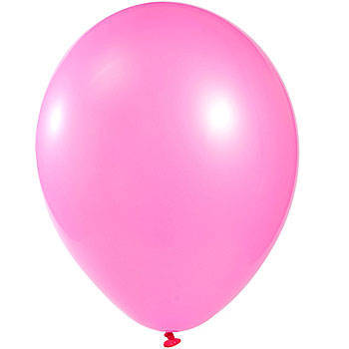


Balloon Info…
Point 10
Point 3
Point -5
Point 5
Point 2

Slide 5

DEAD BALL info…
Dead balloon

Slide 6
Level Contents
Attributes
Time
Life
Point

Slide 7
Maintenance
Point Balloons Dead Balloons

Slide 8
Level Info…
Level -1 (EasyRide):
Time:
Life: 0
Points: 100
Level -2 (Expert):
Time:
Life: 1
Points: 200
Level -3 (Master):
Time:
Life: 2
Points: 300

Slide 9
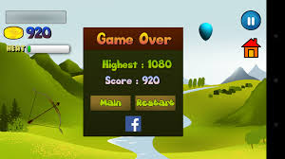
Score Board

Slide 10
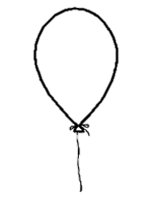


GAME RESULT
You Win!!!

Slide 11

GAME RESULT
You Finish!!!

Slide 12
Let’s make the challange true…
THANK YOU

